Slide 1
Sentence Processing II
Nick Riches
Homework
Defining complexity
An example of complex language
Canonicity
Canonicity across languages
Canonicity and movement Exercise
Movement / canonicity and processing difficulty
Position of embedding Representational complexity
Sentence Processing II
Nick Riches
Newcastle University
Animacy and discourse factors
Animacy
Discourse I - properties of NPs
Putting animacy and discourse together
Discourse II - structure of preceding utterances
May 5, 2020
Putting it all together
Homework Bibliography
1 / 49

Slide 2
Sentence Processing II
Nick Riches
Homework
Homework
Defining complexity
An example of complex language
Canonicity
Canonicity across languages
Canonicity and movement Exercise
Movement / canonicity and processing difficulty
Position of embedding Representational complexity
Defining complexity
Animacy and discourse factors
Putting it all together
Homework Bibliography
Animacy and discourse factors
Animacy
Discourse I - properties of NPs
Putting animacy and discourse together
Discourse II - structure of preceding utterances
Putting it all together
Homework Bibliography
1 / 49

Slide 3
Sentence Processing II
Nick Riches
Homework
Defining complexity
An example of complex language
Canonicity
Canonicity across languages
Canonicity and movement Exercise
Movement / canonicity and processing difficulty
Position of embedding Representational complexity
(1) No head injury is too trival to ignore
Animacy and discourse factors
Animacy
Discourse I - properties of NPs
Putting animacy and discourse together
Discourse II - structure of preceding utterances
Putting it all together
Homework Bibliography
2 / 49

Slide 4
Sentence Processing II
Nick Riches
Homework
Defining complexity
An example of complex language
Canonicity
Canonicity across languages
Canonicity and movement Exercise
Movement / canonicity and processing difficulty
Position of embedding Representational complexity
(1) No head injury is too trival to ignore
(2) INTERPRETATION 1: No head injury should be ignored no matter how trivial
(3) INTERPRETATION 2: All head injuries should be ignored no matter how trivial
Animacy and discourse factors
Animacy
Discourse I - properties of NPs
Putting animacy and discourse together
Discourse II - structure of preceding utterances
Putting it all together
Homework Bibliography
2 / 49

Slide 5
Sentence Processing II
Nick Riches
Homework
Defining complexity
An example of complex language
Canonicity
Canonicity across languages
Canonicity and movement Exercise
Movement / canonicity and processing difficulty
Position of embedding Representational complexity
(4) No donut is too fattening to eat
(5) INTERPRETATION 1: No donut should be eaten no matter how fattening
(6) INTERPRETATION 2: All donuts should be eaten no matter how fattening
Animacy and discourse factors
Animacy
Discourse I - properties of NPs
Putting animacy and discourse together
Discourse II - structure of
preceding utterances
Putting it all
together
Homework
Bibliography
3 / 49

Slide 6
Sentence Processing II
Nick Riches
Homework
Defining complexity
An example of complex language
Canonicity
Canonicity across languages
Canonicity and movement Exercise
Movement / canonicity and processing difficulty
Position of embedding Representational complexity
So “No head injury is too trivial to ignore” actually means “All head injuries should be ignored no matter how trivial”.
Lexical semantics + world knowledge ⇒ Wrong
interpretation.
“Goodenough” theory of language comprehension (Fernanda Ferreira)
We process language in a relatively shallow way, doing just enough processing to extract a contextually-relevant meaning, but no more.
Animacy and discourse factors
Animacy
Discourse I - properties of NPs
Putting animacy and discourse together
Discourse II - structure of
preceding utterances
Putting it all
together
Homework
Bibliography
4 / 49

Slide 7
Sentence Processing II
Nick Riches
Homework
Homework
Defining complexity
An example of complex language
Canonicity
Canonicity across languages
Canonicity and movement Exercise
Movement / canonicity and processing difficulty
Position of embedding Representational complexity
Defining complexity
Animacy and discourse factors
Putting it all together
Homework Bibliography
Animacy and discourse factors
Animacy
Discourse I - properties of NPs
Putting animacy and discourse together
Discourse II - structure of preceding utterances
Putting it all
together
Homework
Bibliography
4 / 49

Slide 8
An example of complex language
Sentence Processing II
Nick Riches
Homework
Defining complexity
An example of complex language
Canonicity
Canonicity across languages
Canonicity and movement Exercise
Movement / canonicity and processing difficulty
Position of embedding Representational complexity
(7) The cat chased the mouse
(8) The mouse was chased by the cat
Which is more complex and why?
Animacy and discourse factors
Animacy
Discourse I - properties of NPs
Putting animacy and discourse together
Discourse II - structure of preceding utterances
Putting it all together
Homework Bibliography
5 / 49

Slide 9
An example of complex language
Sentence Processing II
Nick Riches
Homework
Defining complexity
An example of complex language
Canonicity
Canonicity across languages
Canonicity and movement Exercise
Movement / canonicity and processing difficulty
Position of embedding Representational complexity
label
The mouse
was chased t by the cat
(9)
Animacy and discourse factors
Animacy
Discourse I - properties of NPs
Putting animacy and discourse together
Discourse II - structure of preceding utterances
Putting it all together
Homework Bibliography
6 / 49

Slide 10
An example of complex language
Sentence Processing II
Nick Riches
Homework
Defining complexity
An example of complex language
Canonicity
Canonicity across languages
Canonicity and movement Exercise
Movement / canonicity and processing difficulty
Position of embedding Representational complexity
Difficulty with passives
Semantically non-canonical word order: the patient comes before the agent
They are derived via syntactic movement (movement of NP the mouse from after the verb chased)
Animacy and discourse factors
Animacy
Discourse I - properties of NPs
Putting animacy and discourse together
Discourse II - structure of preceding utterances
Putting it all together
Homework Bibliography
7 / 49

Slide 11
Canonicity
Sentence Processing II
Nick Riches
Homework
Defining complexity
An example of complex language
Canonicity
Canonicity across languages
Canonicity and movement Exercise
Movement / canonicity and processing difficulty
Position of embedding Representational complexity
‘Canonical’ = ‘typical’ / ‘standard’
We can refer to syntactic and semantic canonicity.
In syntactically canonical sentences, the subject comes before the object.
Animacy and discourse factors
Animacy
Discourse I - properties of NPs
Putting animacy and discourse together
Discourse II - structure of preceding utterances
(10) The teenager _{SUBJ} likes parties _{OBJ}
Putting it all together
Homework Bibliography
8 / 49

Slide 12
Canonicity
Sentence Processing II
Nick Riches
Homework
Defining complexity
An example of complex language
Canonicity
Canonicity across languages
Canonicity and movement Exercise
Movement / canonicity and processing difficulty
Position of embedding Representational complexity
In semantically canonical sentences, there is an alignment between the Subject and the Agent argument (and Object and Patient)
(11) The man _{AG} ate the donut _{PAT}
Animacy and discourse factors
Animacy
Discourse I - properties of NPs
Putting animacy and discourse together
Discourse II - structure of preceding utterances
(12) The dog _{AG} chased the cat _{PAT}
Putting it all together
Homework Bibliography
9 / 49

Slide 13
Canonicity
Sentence Processing II
Nick Riches
Homework
Defining complexity
An example of complex language
Canonicity
Canonicity across languages
Canonicity and movement Exercise
Movement / canonicity and processing difficulty
Position of embedding Representational complexity
In some cases the subject may not be an Agent, but it will definitely have more agency than the object
(13) The boy _{AG}/ smelt the rose _{TH}
EXP
Animacy and discourse factors
Animacy
Discourse I - properties of NPs
Putting animacy and discourse together
Discourse II - structure of preceding utterances
So Subject maps to the most agentive argument, while Object maps onto the least agentive argument.
Putting it all
together
Homework
Bibliography

Slide 14
Canonicity
Sentence Processing II
Nick Riches
Homework
Examples of non-canonical sentences
Defining complexity
An example of complex language
Canonicity
Canonicity across languages
Canonicity and movement Exercise
Movement / canonicity and processing difficulty
Position of embedding Representational complexity
label
The mouse was chased t by the cat
(14)
Animacy and discourse factors
Animacy
Discourse I - properties of NPs
Putting animacy and discourse together
Discourse II - structure of preceding utterances
Syntactically canonical - subject comes before verb
Semantically non-canonical - subject maps to least agentive argument
Putting it all
together
Homework
Bibliography

Slide 15
Canonicity
Sentence Processing II
Nick Riches
Homework
Defining complexity
An example of complex language
Canonicity
Canonicity across languages
Canonicity and movement Exercise
Movement / canonicity and processing difficulty
Position of embedding Representational complexity
label
There ’s the mouse that the cat chased t
(15)
Syntactically non-canonical - Object comes before Subject Semantically canonical - Subject maps to Agent argument
Animacy and discourse factors
Animacy
Discourse I - properties of NPs
Putting animacy and discourse together
Discourse II - structure of preceding utterances
Putting it all
together
Homework
Bibliography

Slide 16
Canonicity
Sentence Processing II
Nick Riches
Homework
For three place predicates, which is the canonical word order?
Defining complexity
An example of complex language
Canonicity
Canonicity across languages
Canonicity and movement Exercise
Movement / canonicity and processing difficulty
Position of embedding Representational complexity
John gave
John gave DATIVE)
(DITRANSITIVE)
her _{Oi} | a b | ook | Od
a book _{Od} |  | to | her |  | Oi
(PREPOSITIONAL
Animacy and discourse factors
Animacy
Discourse I - properties of NPs
Putting animacy and discourse together
Discourse II - structure of preceding utterances
Putting it all
together
Homework
Bibliography
13 / 49

Slide 17
Canonicity
Sentence Processing II
Nick Riches
Homework
For three place predicates, which is the canonical word order?
Defining complexity
An example of complex language
Canonicity
Canonicity across languages
Canonicity and movement Exercise
Movement / canonicity and processing difficulty
Position of embedding Representational complexity
John gave
John gave DATIVE)
John read
John wore
(DITRANSITIVE)
her _{Oi} | a b | ook | Od
a book _{Od} |  | to | her |  | Oi
(PREPOSITIONAL
a book _{Od} [ in the park ]
a blue blazer _{Od} [ for the party ]
Animacy and discourse factors
Animacy
Discourse I - properties of NPs
Putting animacy and discourse together
Discourse II - structure of preceding utterances
Prepositional dative assumed to be canonical as its basic structure (V + Od + Prepositional Phrase) is far more frequent
Putting it all
together
Homework
Bibliography
13 / 49

Slide 18
Canonicity
Sentence Processing II
Nick Riches
Homework
Defining complexity
An example of complex language
Canonicity
Canonicity across languages
Canonicity and movement Exercise
Movement / canonicity and processing difficulty
Position of embedding Representational complexity
English is SVO (40%)
Japanese is SOV (35%)
Classical Arabic is VSO (15%)
Fijian is VOS (10%)
Xavante is OSV (<1%)
Hixkarayana is OVS (<1%)
Animacy and discourse factors
Animacy
Discourse I - properties of NPs
Putting animacy and discourse together
Discourse II - structure of preceding utterances
Strong tendency for S > O (75% of world’s languages) and weaker tendency for V > O (65%)
Putting it all
together
Homework
Bibliography
14 / 49

Slide 19
Canonicity
Sentence Processing II
Nick Riches
Homework
Defining complexity
An example of complex language
Canonicity
Canonicity across languages
Canonicity and movement Exercise
Movement / canonicity and processing difficulty
Position of embedding Representational complexity
Some languages allow words to come in almost any order,
e.g. Latin & Finnish.
However, even these have a preferred word order, e.g. it has been argued that the basic Latin word order is OSV.
Animacy and discourse factors
Animacy
Discourse I - properties of NPs
Putting animacy and discourse together
Discourse II - structure of preceding utterances
Putting it all
together
Homework
Bibliography

Slide 20
Canonicity
Sentence Processing II
Nick Riches
Homework
Defining complexity
An example of complex language
Canonicity
Canonicity across languages
Canonicity and movement Exercise
Movement / canonicity and processing difficulty
Position of embedding Representational complexity
Syntactically non-canonical sentences are assumed by many linguists to result from a movement process:
label
Animacy and discourse factors
Animacy
Discourse I - properties of NPs
Putting animacy and discourse together
The mouse
was chased
t by the cat
(16)
‘filler’
‘gap’ or ‘trace’
Discourse II - structure of preceding utterances
Putting it all
together
Homework
Bibliography

Slide 21
Canonicity
Sentence Processing II
Nick Riches
Homework
Defining complexity
An example of complex language
Canonicity
Canonicity across languages
Canonicity and movement Exercise
Movement / canonicity and processing difficulty
Position of embedding Representational complexity
Are the following sentences syntactically canonical? For non-canonical sentences specify the filler and the gap?
It was the boy that the girl pushed
The boy apparently pushed the girl into the puddle
The boy that the girl pushed was upset
The boy was pushed by the girl
The boy that pushed the girl was naughty
It was the boy that pushed the girl
Animacy and discourse factors
Animacy
Discourse I - properties of NPs
Putting animacy and discourse together
Discourse II - structure of preceding utterances
Putting it all
together
Homework
Bibliography

Slide 22
Canonicity
Sentence Processing II
Nick Riches
Homework
label
Defining complexity
An example of complex language
Canonicity
Canonicity across languages
Canonicity and movement Exercise
Movement / canonicity and processing difficulty
Position of embedding Representational complexity
It was the boy that the girl pushed t
(1)
(2) The boy apparently pushed the girl into the puddle
label
Animacy and discourse factors
Animacy
Discourse I - properties of NPs
Putting animacy and discourse together
Discourse II - structure of preceding utterances
The boy
that the girl pushed t was upset
(3)
Putting it all
together
Homework
Bibliography

Slide 23
Canonicity
Sentence Processing II
Nick Riches
Homework
Defining complexity
An example of complex language
Canonicity
Canonicity across languages
Canonicity and movement Exercise
Movement / canonicity and processing difficulty
Position of embedding Representational complexity
label
The boy was pushed t by the girl
(4)
The boy that pushed the girl was naughty
It was the boy that pushed the girl
Animacy and discourse factors
Animacy
Discourse I - properties of NPs
Putting animacy and discourse together
Discourse II - structure of
preceding utterances
Putting it all
together
Homework
Bibliography

Slide 24
Canonicity
Sentence Processing II
Nick Riches
Homework
Defining complexity
An example of complex language
Canonicity
Canonicity across languages
Canonicity and movement Exercise
Movement / canonicity and processing difficulty
Position of embedding Representational complexity
Difficulty affected by movement.
Difficulty is greater when movement is longer.
Effect of difficulty is even greater in language-impaired individuals.
Animacy and discourse factors
Animacy
Discourse I - properties of NPs
Putting animacy and discourse together
Discourse II - structure of preceding utterances
Putting it all together
Homework Bibliography
20 / 49

Slide 25
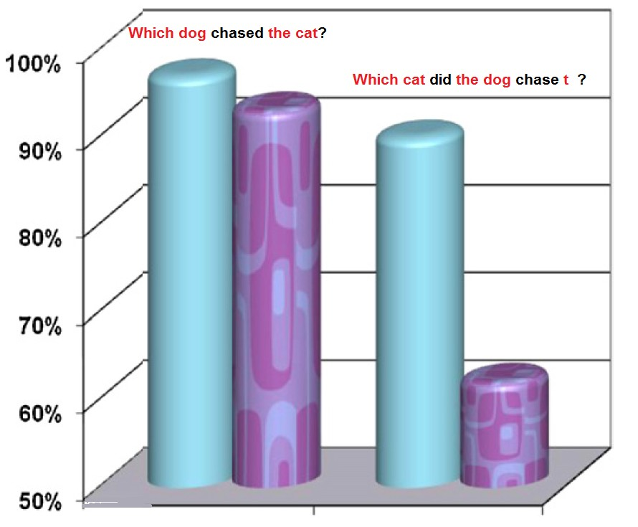
Canonicity
Sentence Processing II
Friedmann & Novogrodsky, 2010
Nick Riches
Homework
Defining complexity
An example of complex language
Canonicity
Canonicity across languages
Canonicity and movement Exercise
Movement / canonicity and processing difficulty
Position of embedding Representational complexity
Animacy and discourse factors
Animacy
Discourse I - properties of NPs
Putting animacy and discourse together
Discourse II - structure of preceding utterances
Putting it all together
Homework Bibliography
21 / 49

Slide 26
Position of embedding
Sentence Processing II
Nick Riches
Homework
Defining complexity
An example of complex language
Canonicity
Canonicity across languages
Canonicity and movement Exercise
Movement / canonicity and processing difficulty
Position of embedding Representational complexity
(17)
The boy
[ that pushed the girl ] was naughty
(18)
The boy pushed the girl [ that was naughty ]
Animacy and discourse factors
Animacy
Discourse I - properties of NPs
Putting animacy and discourse together
Discourse II - structure of preceding utterances
Putting it all together
Homework Bibliography
22 / 49

Slide 27
Position of embedding
Multiple centre-embedding is a nightmare!
(19) The girl [ that the boy [ that the teacher scolded
] pushed ] hurt her knee
(20) There’s the boy [ that the teacher scolded ] [ that pushed hurt her knee ].
the girl
] [ that fell and

Slide 28
Position of embedding
Sentence Processing II
Nick Riches
Homework
Defining complexity
An example of complex language
Canonicity
Canonicity across languages
Canonicity and movement Exercise
Movement / canonicity and processing difficulty
Position of embedding Representational complexity
How can a sentence be grammatically well-formed but almost impossible to understand?
Miller & Chomsky (1963) - separation between grammatical mechanisms and processing mechanisms.
Animacy and discourse factors
Animacy
Discourse I - properties of NPs
Putting animacy and discourse together
Discourse II - structure of preceding utterances
Putting it all together
Homework Bibliography
24 / 49

Slide 29
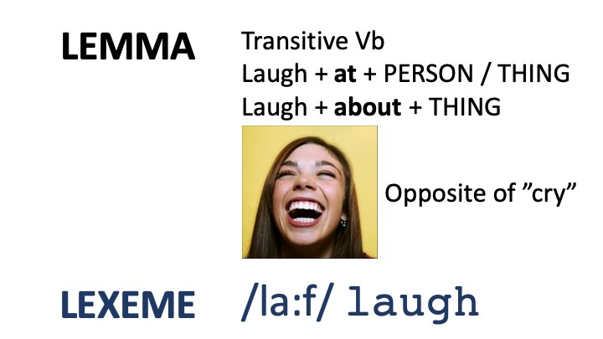
Representational complexity
Sentence Processing II
Nick Riches
Homework
Defining complexity
An example of complex language
Canonicity
Canonicity across languages
Canonicity and movement Exercise
Movement / canonicity and processing difficulty
Position of embedding Representational complexity
Animacy and discourse factors
Animacy
Discourse I - properties of NPs
Putting animacy and discourse together
Discourse II - structure of preceding utterances
Putting it all together
Homework
Bibliography

Slide 30
Representational complexity
Sentence Processing II
Nick Riches
1. Mary the bike
 | fixed
donated
donated
 | gave
 | gave
 | gave
 | said
 | said
 | asked
 | asked
 | asked
 | asked
 | asked
Homework
Ali
Ali
a book to the library a book
Peter a book
a book to Peter a book
Defining complexity
An example of complex language
Canonicity
Canonicity across languages
Canonicity and movement Exercise
Movement / canonicity and processing difficulty
Position of embedding Representational complexity
4. Angie
5. Angie
6. Angie
7. Janet
her prayers
8. Janet
that she was sorry
Animacy and discourse factors
Animacy
Discourse I - properties of NPs
Putting animacy and discourse together
Discourse II - structure of preceding utterances
9. Erica
a question
about the interview Mary a question whether Mary was tired Mary to be quiet
10. Erica
11. Erica
Putting it all together
12. Erica
13. Erica
Homework
Bibliography

Slide 31
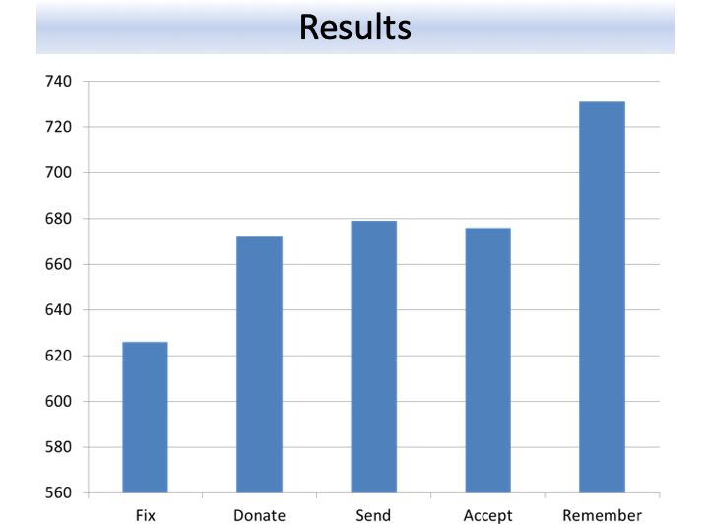
Representational complexity
Sentence Processing II
Shapiro et al. (1987) used a lexical decision task to test processing difficulty after the verb.
Nick Riches
Homework
Defining complexity
An example of complex language
Canonicity
Canonicity across languages
Canonicity and movement Exercise
Movement / canonicity and processing difficulty
Position of embedding Representational complexity
Animacy and discourse factors
Animacy
Discourse I - properties of NPs
Putting animacy and discourse together
Discourse II - structure of preceding utterances
Putting it all together
Homework
Bibliography

Slide 32
Representational complexity
Sentence Processing II
Nick Riches
Homework
Defining complexity
An example of complex language
Canonicity
Canonicity across languages
Canonicity and movement Exercise
Movement / canonicity and processing difficulty
Position of embedding Representational complexity
Ali
Ali
Ali
Ali
Ali
the milk
that she had to buy the milk to buy the milk
how to make ice milk lollies
his mother making him ice milk
remembered
remembered
remembered
remembered
remembered
lollies
Animacy and discourse factors
Animacy
Discourse I - properties of NPs
Putting animacy and discourse together
6. Ali remembered when his mother used to make him
ice milk lollies
Discourse II - structure of preceding utterances
Putting it all
together
Homework
Bibliography

Slide 33
Representational complexity
Sentence Processing II
Nick Riches
Homework
Defining complexity
An example of complex language
Canonicity
Canonicity across languages
Canonicity and movement Exercise
Movement / canonicity and processing difficulty
Position of embedding Representational complexity
Effect of number of arguments, or subcategorisation complexity?
Animacy and discourse factors
Animacy
Discourse I - properties of NPs
Putting animacy and
discourse together
Discourse II - structure of preceding utterances
Putting it all
together
Homework
Bibliography

Slide 34
Sentence Processing II
Nick Riches
Homework
Homework
Defining complexity
An example of complex language
Canonicity
Canonicity across languages
Canonicity and movement Exercise
Movement / canonicity and processing difficulty
Position of embedding Representational complexity
Defining complexity
Animacy and discourse factors
Putting it all together
Homework Bibliography
Animacy and discourse factors
Animacy
Discourse I - properties of NPs
Putting animacy and discourse together
Discourse II - structure of preceding utterances
Putting it all together
Homework Bibliography
29 / 49

Slide 35
Animacy
Sentence Processing II
Nick Riches
Homework
Defining complexity
An example of complex language
Canonicity
Canonicity across languages
Canonicity and movement Exercise
Movement / canonicity and processing difficulty
Position of embedding Representational complexity
Because animate entities (people, animals) have volition, they make good agents.
Agents typically occur in subject position.
(21) The boy ate the sausage
Animacy and discourse factors
Animacy
Discourse I - properties of NPs
Putting animacy and discourse together
Discourse II - structure of preceding utterances
Putting it all together
Homework Bibliography
30 / 49

Slide 36
Animacy
Sentence Processing II
Nick Riches
Homework
Defining complexity
An example of complex language
Canonicity
Canonicity across languages
Canonicity and movement Exercise
Movement / canonicity and processing difficulty
Position of embedding Representational complexity
Because inanimate entities (e.g. objects) do not have volition, they do not make good agents.
Non-agents typically occur in object position.
(22) The boy ate the sausage
Animacy and discourse factors
Animacy
Discourse I - properties of NPs
Putting animacy and discourse together
Discourse II - structure of preceding utterances
Putting it all together
Homework Bibliography
31 / 49

Slide 37
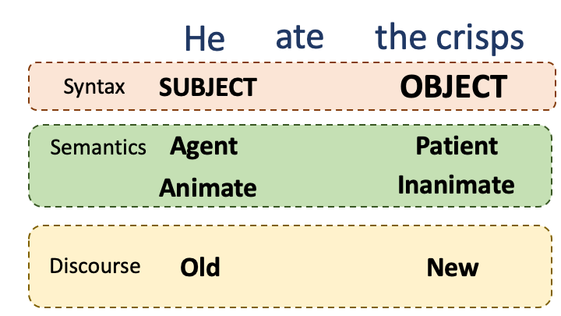
Animacy
Sentence Processing II
Nick Riches
Homework
Defining complexity
An example of complex language
Canonicity
Canonicity across languages
Canonicity and movement Exercise
Movement / canonicity and processing difficulty
Position of embedding Representational complexity
Animacy and discourse factors
Animacy
Discourse I - properties of NPs
Putting animacy and discourse together
Discourse II - structure of preceding utterances
Putting it all together
Homework Bibliography
32 / 49

Slide 38
Animacy
Sentence Processing II
Nick Riches
Homework
Defining complexity
An example of complex language
Canonicity
Canonicity across languages
Canonicity and movement Exercise
Movement / canonicity and processing difficulty
Position of embedding Representational complexity
Because of these correspondences, animacy cues can help children determine who did what to whom, e.g.
Which are easiest?
1.
2.
3.
The boy that the rock squashed was large
The car that the man drove was fast
Animacy and discourse factors
Animacy
Discourse I - properties of NPs
Putting animacy and discourse together
Discourse II - structure of preceding utterances
The cow that the pig chased was spotted
Putting it all together
Homework Bibliography
33 / 49

Slide 39
Discourse I - properties of NPs
Sentence Processing II
Nick Riches
Homework
Defining complexity
An example of complex language
Canonicity
Canonicity across languages
Canonicity and movement Exercise
Movement / canonicity and processing difficulty
Position of embedding Representational complexity
Different argument slots also have particular discourse properties. The subject position often contains discourse-old information, e.g.
(23) I like John. He’s a nice guy.
Animacy and discourse factors
Animacy
Discourse I - properties of NPs
Putting animacy and discourse together
Discourse II - structure of preceding utterances
Putting it all together
Homework Bibliography
34 / 49

Slide 40
Discourse I - properties of NPs
Sentence Processing II
Nick Riches
Homework
Defining complexity
An example of complex language
Canonicity
Canonicity across languages
Canonicity and movement Exercise
Movement / canonicity and processing difficulty
Position of embedding Representational complexity
(24) Have you heard about John? He won the lottery
Animacy and discourse factors
Animacy
Discourse I - properties of NPs
Putting animacy and discourse together
Discourse II - structure of preceding utterances
Putting it all together
Homework Bibliography
35 / 49

Slide 41
Discourse I - properties of NPs
Sentence Processing II
Nick Riches
Homework
Defining complexity
An example of complex language
Canonicity
Canonicity across languages
Canonicity and movement Exercise
Movement / canonicity and processing difficulty
Position of embedding Representational complexity
Animacy and discourse factors
Animacy
Discourse I - properties of NPs
Putting animacy and discourse together
Discourse II - structure of
preceding utterances
Putting it all
together
Homework
Bibliography

Slide 42
Discourse I - properties of NPs
Sentence Processing II
Nick Riches
Homework
Defining complexity
An example of complex language
Canonicity
Canonicity across languages
Canonicity and movement Exercise
Movement / canonicity and processing difficulty
Position of embedding Representational complexity
Complex structures are a lot easier to process when subjects have typical discourse properties (i.e. they are pronominal)
There’s the dog he chased Subject is pronominal = EASY
There’s the dog the boy chased Subject is a full Noun Phrase = DIFFICULT
Animacy and discourse factors
Animacy
Discourse I - properties of NPs
Putting animacy and discourse together
Discourse II - structure of
preceding utterances
Putting it all
together
Homework
Bibliography

Slide 43
Discourse I - properties of NPs
Sentence Processing II
Nick Riches
Homework
Defining complexity
An example of complex language
Canonicity
Canonicity across languages
Canonicity and movement Exercise
Movement / canonicity and processing difficulty
Position of embedding Representational complexity
(27) Which dog was he chasing ?
Subject is pronominal = EASY
(28) Which dog was the boy chasing ?
Animacy and discourse factors
Animacy
Discourse I - properties of NPs
Putting animacy and discourse together
Subject is a full Noun Phrase = DIFFICULT
Discourse II - structure of preceding utterances
Putting it all
together
Homework
Bibliography

Slide 44
Putting animacy and discourse together
Sentence Processing II
Nick Riches
Homework
Defining complexity
An example of complex language
Canonicity
Canonicity across languages
Canonicity and movement Exercise
Movement / canonicity and processing difficulty
Position of embedding Representational complexity
We can manipulate difficulty be combining animacy and discourse cues
There’s the hammer he dropped Supportive animacy and discourse cues
There’s the boy that the girl chased Unsupportive animacy and discourse cues
Animacy and discourse factors
Animacy
Discourse I - properties of NPs
Putting animacy and discourse together
Discourse II - structure of
preceding utterances
Putting it all
together
Homework
Bibliography

Slide 45
Putting animacy and discourse together
Sentence Processing II
Nick Riches
Animacy and discourse can actually “trump” syntactic complexity, e.g.
There’s the hammer he dropped
Noncanonical structure, but supportive animacy/discourse cues
There’s the girl that chased the boy
Canonical structure, but unsupportive animacy/discourse cues
Kidd et al. (2007) found that kids were actually better at
Homework
Defining complexity
An example of complex language
Canonicity
Canonicity across languages
Canonicity and movement Exercise
Movement / canonicity and processing difficulty
Position of embedding Representational complexity
Animacy and discourse factors
Animacy
Discourse I - properties of NPs
Putting animacy and discourse together
Discourse II - structure of preceding utterances
Putting it all together
repeating (31) than (32)
Homework
Bibliography

Slide 46
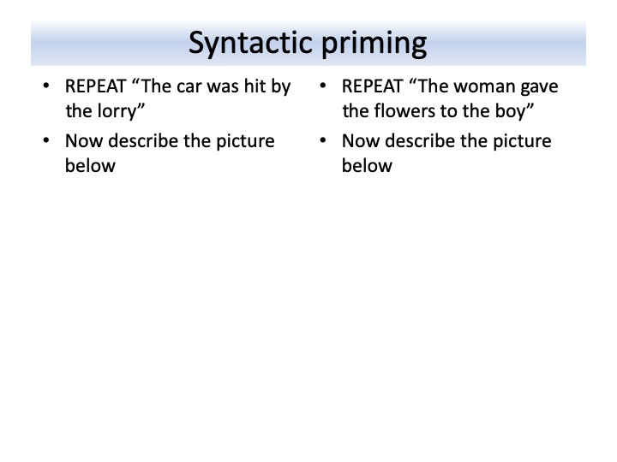
Discourse II - structure of preceding utterances
Sentence Processing II
Nick Riches
Homework
Defining complexity
An example of complex language
Canonicity
Canonicity across languages
Canonicity and movement Exercise
Movement / canonicity and processing difficulty
Position of embedding Representational complexity
Animacy and discourse factors
Animacy
Discourse I - properties of NPs
Putting animacy and discourse together
Discourse II - structure of preceding utterances
Putting it all together
Homework
Bibliography

Slide 47
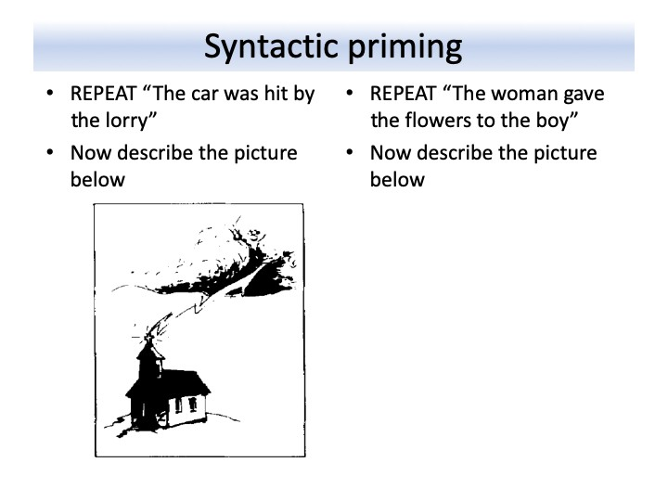
Discourse II - structure of preceding utterances
Sentence Processing II
Nick Riches
Homework
Defining complexity
An example of complex language
Canonicity
Canonicity across languages
Canonicity and movement Exercise
Movement / canonicity and processing difficulty
Position of embedding Representational complexity
Animacy and discourse factors
Animacy
Discourse I - properties of NPs
Putting animacy and discourse together
Discourse II - structure of preceding utterances
Putting it all together
Homework Bibliography
42 / 49

Slide 48
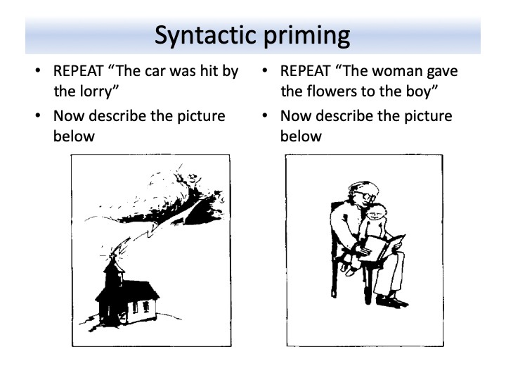
Discourse II - structure of preceding utterances
Sentence Processing II
Nick Riches
Homework
Defining complexity
An example of complex language
Canonicity
Canonicity across languages
Canonicity and movement Exercise
Movement / canonicity and processing difficulty
Position of embedding Representational complexity
Animacy and discourse factors
Animacy
Discourse I - properties of NPs
Putting animacy and discourse together
Discourse II - structure of
preceding utterances
Putting it all
together
Homework
Bibliography

Slide 49
Discourse II - structure of preceding utterances
Sentence Processing II
Nick Riches
Homework
Defining complexity
An example of complex language
Canonicity
Canonicity across languages
Canonicity and movement Exercise
Movement / canonicity and processing difficulty
Position of embedding Representational complexity
We have a natural tendency to recycle the structure of preceding utterances. This is demonstrated by structural priming studies.
The participant hears a structure
The participant describes a picture which can either be produced with the preceding structure or a different structure
Animacy and discourse factors
Animacy
Discourse I - properties of NPs
Putting animacy and discourse together
Discourse II - structure of
Participants use preceding structures at above-chance level.
preceding utterances
Putting it all
together
Homework
Bibliography

Slide 50
Discourse II - structure of preceding utterances
Sentence Processing II
Nick Riches
Homework
Defining complexity
An example of complex language
Canonicity
Canonicity across languages
Canonicity and movement Exercise
Movement / canonicity and processing difficulty
Position of embedding Representational complexity
Syntactic priming is a much studied phenomenon.
Consequence of an implicit structural learning mechanism (Peter et al. 2015).
Structural priming is widely employed in intervention (Leonard, 2011).
However, language-impaired children may be less susceptible to structural priming (Kidd, 2012)
Animacy and discourse factors
Animacy
Discourse I - properties of NPs
Putting animacy and
discourse together
Discourse II - structure of preceding utterances
Putting it all
together
Homework
Bibliography
45 / 49

Slide 51
Sentence Processing II
Nick Riches
Homework
Homework
Defining complexity
An example of complex language
Canonicity
Canonicity across languages
Canonicity and movement Exercise
Movement / canonicity and processing difficulty
Position of embedding Representational complexity
Defining complexity
Animacy and discourse factors
Putting it all together
Homework Bibliography
Animacy and discourse factors
Animacy
Discourse I - properties of NPs
Putting animacy and
discourse together
Discourse II - structure of preceding utterances
Putting it all
together
Homework
Bibliography
45 / 49

Slide 52
Sentence Processing II
Nick Riches
Homework
You can manipulate the complexity of sentences via the following:
Defining complexity
An example of complex language
Canonicity
Canonicity across languages
Canonicity and movement Exercise
Movement / canonicity and processing difficulty
Position of embedding Representational complexity
Length of movement
Position of embedding (centre or final)
Representational properties of verbs
Animacy
Discourse properties of arguments (Noun or Pronoun)
Properties of preceding sentences (structural priming)
Animacy and discourse factors
Animacy
Discourse I - properties of NPs
Putting animacy and discourse together
Discourse II - structure of preceding utterances
We can therefore create difficutly gradients. But how do we
use these in clinics?
Putting it all
together
Homework
Bibliography
46 / 49

Slide 53
Sentence Processing II
Nick Riches
Homework
Homework
Defining complexity
An example of complex language
Canonicity
Canonicity across languages
Canonicity and movement Exercise
Movement / canonicity and processing difficulty
Position of embedding Representational complexity
Defining complexity
Animacy and discourse factors
Putting it all together
Homework Bibliography
Animacy and discourse factors
Animacy
Discourse I - properties of NPs
Putting animacy and
discourse together
Discourse II - structure of preceding utterances
Putting it all
together
Homework
Bibliography
46 / 49

Slide 54
Sentence Processing II
Nick Riches
Homework
Defining complexity
An example of complex language
Canonicity
Canonicity across languages
Canonicity and movement Exercise
Movement / canonicity and processing difficulty
Position of embedding Representational complexity
Complete the following sentences
It’s a game of two
Her presentation was all over
What’s a nice girl like you
4. Who’d a ?
Animacy and discourse factors
Animacy
Discourse I - properties of NPs
Putting animacy and discourse together
How many possibilities were there? What kind of factors influenced your completions?
Discourse II - structure of preceding utterances
Putting it all
together
Homework
Bibliography
47 / 49

Slide 55
Sentence Processing II
Nick Riches
Homework
Homework
Defining complexity
An example of complex language
Canonicity
Canonicity across languages
Canonicity and movement Exercise
Movement / canonicity and processing difficulty
Position of embedding Representational complexity
Defining complexity
Animacy and discourse factors
Putting it all together
Homework Bibliography
Animacy and discourse factors
Animacy
Discourse I - properties of NPs
Putting animacy and
discourse together
Discourse II - structure of preceding utterances
Putting it all
together
Homework
Bibliography
47 / 49

Slide 56
Sentence Processing II
Nick Riches
Ferreira, F., Bailey, K. G. D., & Ferraro, V. (2000). Good enough representations in language comprehension. Web Publication.
Kidd, E., Brandt, S., Lieven, E., & Tomasello, M. (2007). Object relatives made easy: A cross-linguistic comparison of the constraints influencing young children’s processing of relative clauses. Language and Cognitive Processes, 22(6), 860–897.
Kidd, E. (2012). Individual differences in syntactic priming in language acquisition. Applied Psycholinguistics, 33(02), 393–418.
Leonard, L. B. (2011). The Primacy of Priming in Grammatical Learning and Intervention: A Tutorial. J
Homework
Defining complexity
An example of complex language
Canonicity
Canonicity across languages
Canonicity and movement Exercise
Movement / canonicity and processing difficulty
Position of embedding Representational complexity
Animacy and discourse factors
Animacy
Discourse I - properties of NPs
Putting animacy and discourse together
Discourse II - structure of preceding utterances
Putting it all together
Speech Lang Hear Res, 54(2), 608–621
Homework
Bibliography
48 / 49

Slide 57
Sentence Processing II
Nick Riches
Miller, G. A., & Chomsky, N. (1963). Finitary Models of Language Users. In R. D. Luce, R. R. Bush, & E. Galanter (Eds.), Handbook of Mathematical Psychology (Vol. 2, pp. 419ˆa491). Wiley, NY.
Peter, M., Chang, F., Pine, J. M., Blything, R., & Rowland,
C. F. (2015). When and how do children develop knowledge of verb argument structure? Evidence from verb bias effects in a structural priming task. Journal of Memory and Language, 81, 1–15. https://doi.org/10.1016/j.jml.2014.12.002
Shapiro, L. P., Zurif, E., & Grimshaw, J. (1987). Sentence processing and the mental representation of verbs.
Cognition, 27(3), 219–246.
Homework
Defining complexity
An example of complex language
Canonicity
Canonicity across languages
Canonicity and movement Exercise
Movement / canonicity and processing difficulty
Position of embedding Representational complexity
Animacy and discourse factors
Animacy
Discourse I - properties of NPs
Putting animacy and discourse together
Discourse II - structure of preceding utterances
Putting it all together
https://doi.org/10.1016/S0010-0277(87)80010-0
Homework
Bibliography
49 / 49

